Slide 1
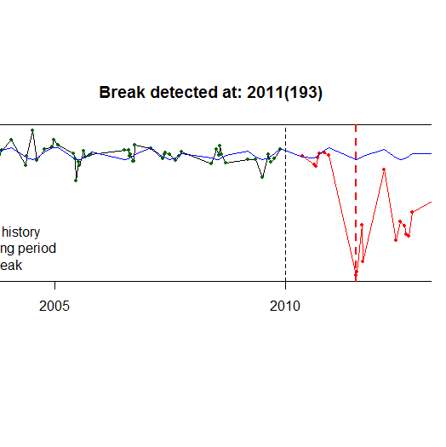
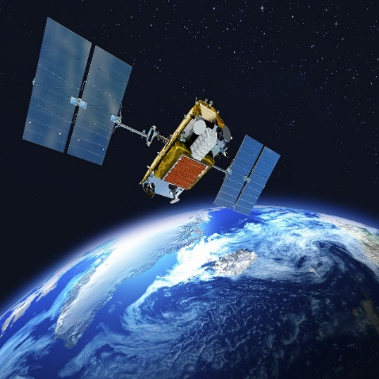
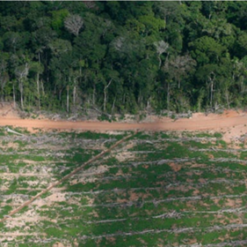
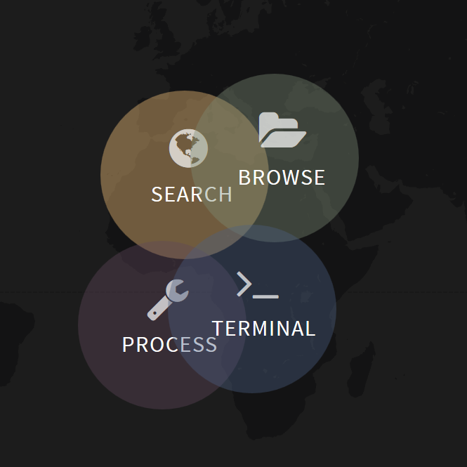
Experimental demo
Large-scale development GPU-BFAST
Fabian Gieseke
Sabina Rosca

Slide 2
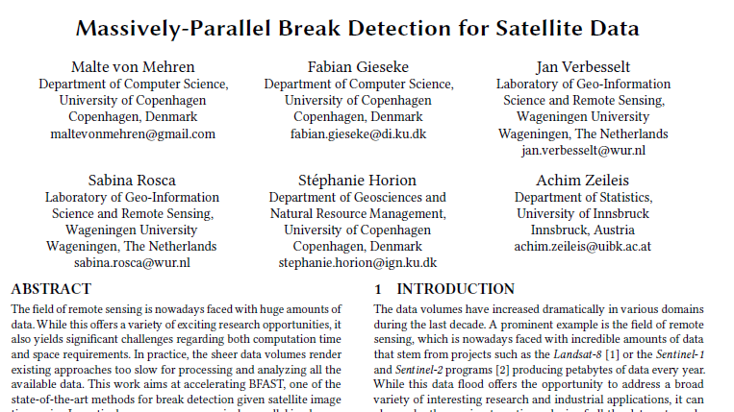
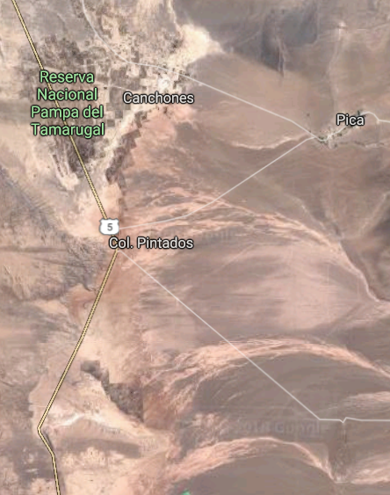
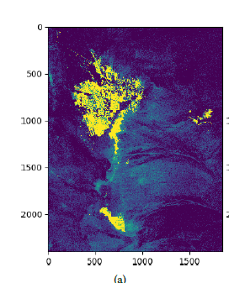
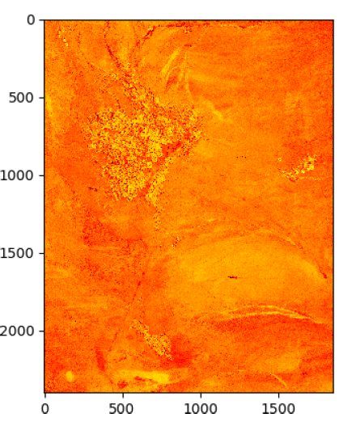
1st development
Only datasets with no NA values
BFAST(R) in SEPAL 36CPU: 5,540 s (92.3 min)
1,000 times slower
BFAST(GPU): 3.9 s
400,000 ha - Atacama Desert

Slide 3
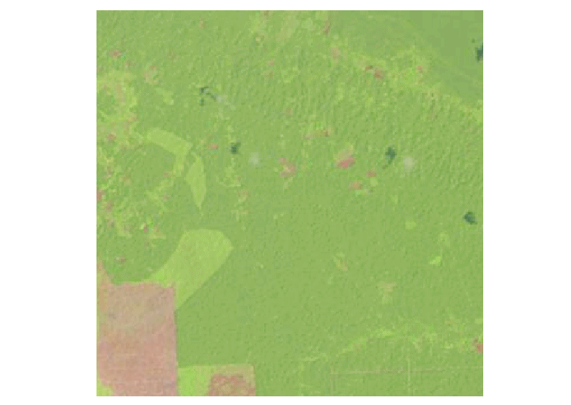
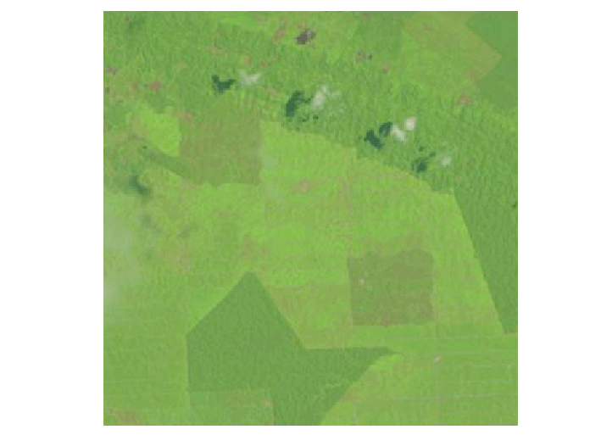

Real-world solution
Account for datasets with missing data
10 000 ha - Peru
36 CPU: 1.85 min

Slide 4
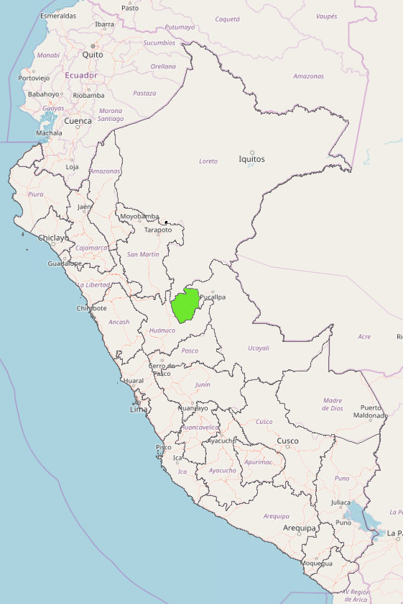
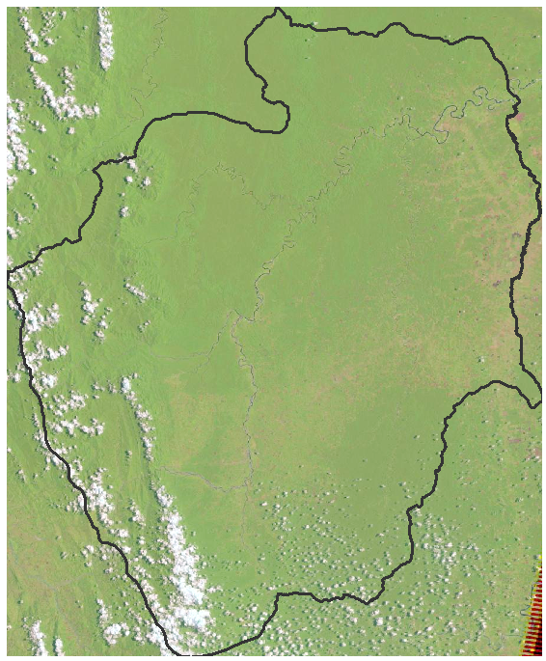
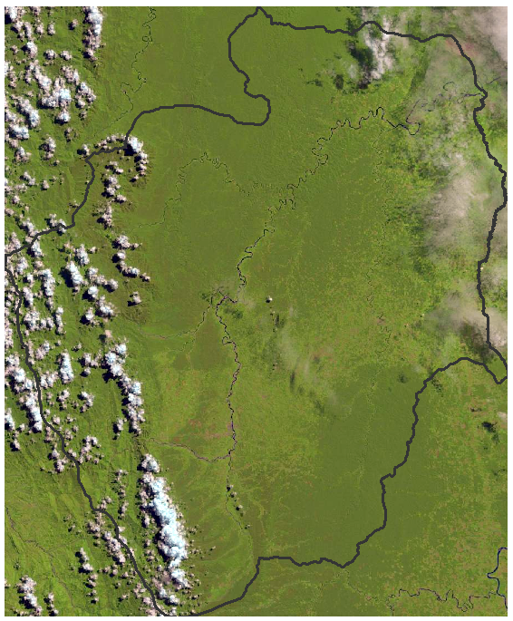
Going big scale
Peru, Padre Abad
Ready to test it on larger areas
882 250 ha – Padre Abad region
2009
2013
4

Slide 5
Experimental demo

Slide 6
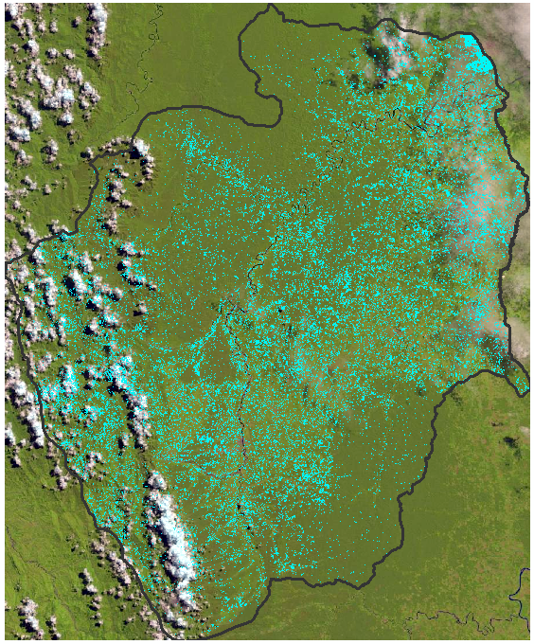
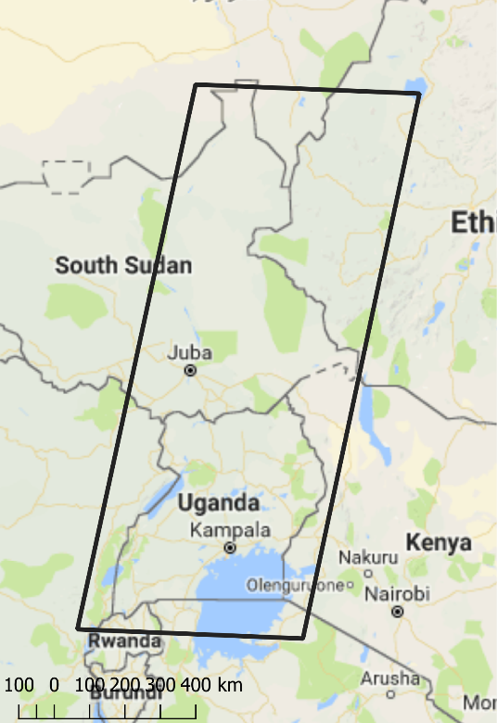
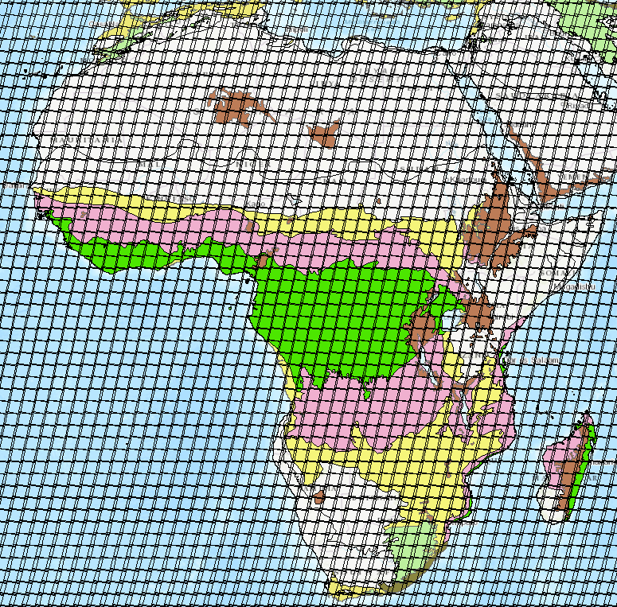
Discussion points
This is work in progress

